Slide 1
ONLINE BUS TICKET BOOKING SYSTEM

Slide 2
PROJECT DEFINITION
In this Online Bus Ticket Booking System we develop the system that can help the user to book their ticket online.
We take care of every services related to travelling and online ticket booking.
When you start your traveling tour you have to book ticket so we help you in booking your traveling ticket.

Slide 3
ABSTRACT
Online Bus ticket booking system consists of collection of buses customer book tickets for their journey according to the bus name and departure time of the bus, According to its name it manages the details of all tickets, name, email and timing details and so on. It also manages the updating of the objects.
This section also contains the details of booking time of the seats or collecting of the tickets, this section also contain the booking date and the name of agent which is optional, by which the customer can reserve the seats for his journey

Slide 4
SOFTWARE REQUIREMENT
Front end : Java
Back end : Mysql(JDBC CONNECTION)

Slide 5
HARDWARE REQUIREMENT
Processor : Intel® Pentium®
RAM :4.00 GB
Operating System : Windows 7

Slide 6
ADVANTAGE
Online bus ticket booking system makes it easier for a customers to book tickets online.
It reduces the time as they don’t have to stand in long queues or search ticket at different bus ticket counter.
Thus it provides better work efficiency, security, reliability in the field of online bus ticket booking system.

Slide 7
DISADVANTAGE
It needs internet access

Slide 8
MODULE
Insert
Read
Update
Delete

Slide 9
ER-DIAGRAM OF ONLINE BUS TICKET BOOKING
Booking
Name
TicketCost
Gender
No.of Passangers
Ticket
Email
Date
Travels
Name
From
To
Time

Slide 10
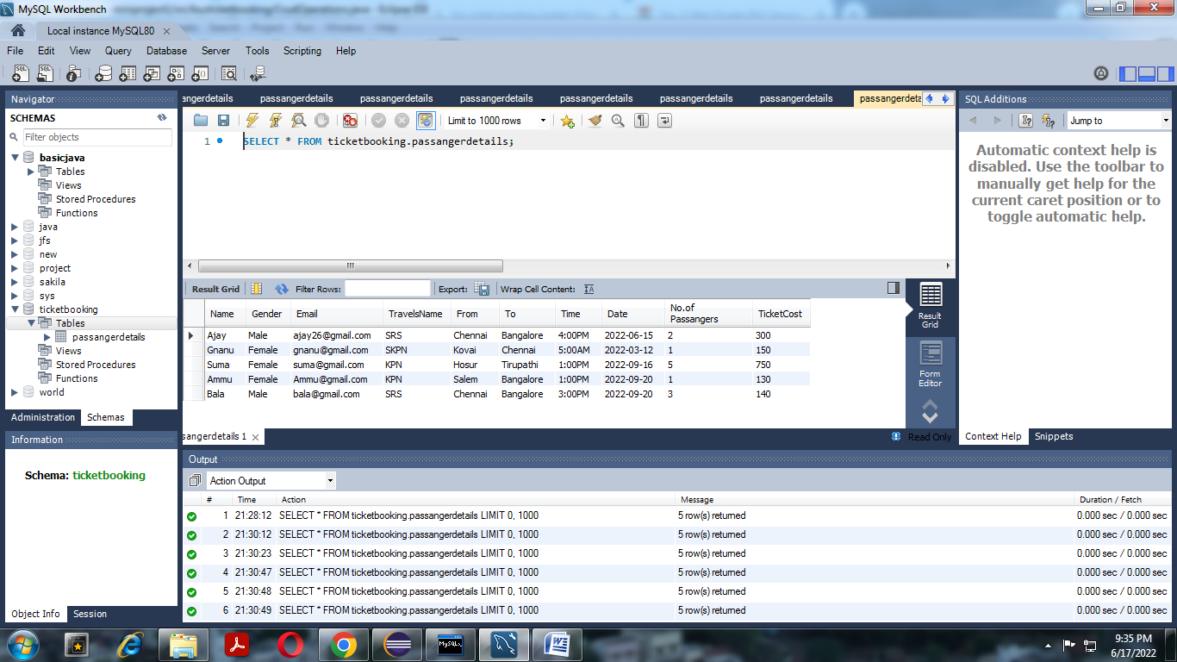
SCREENSCHOT: (INSERT)

Slide 11
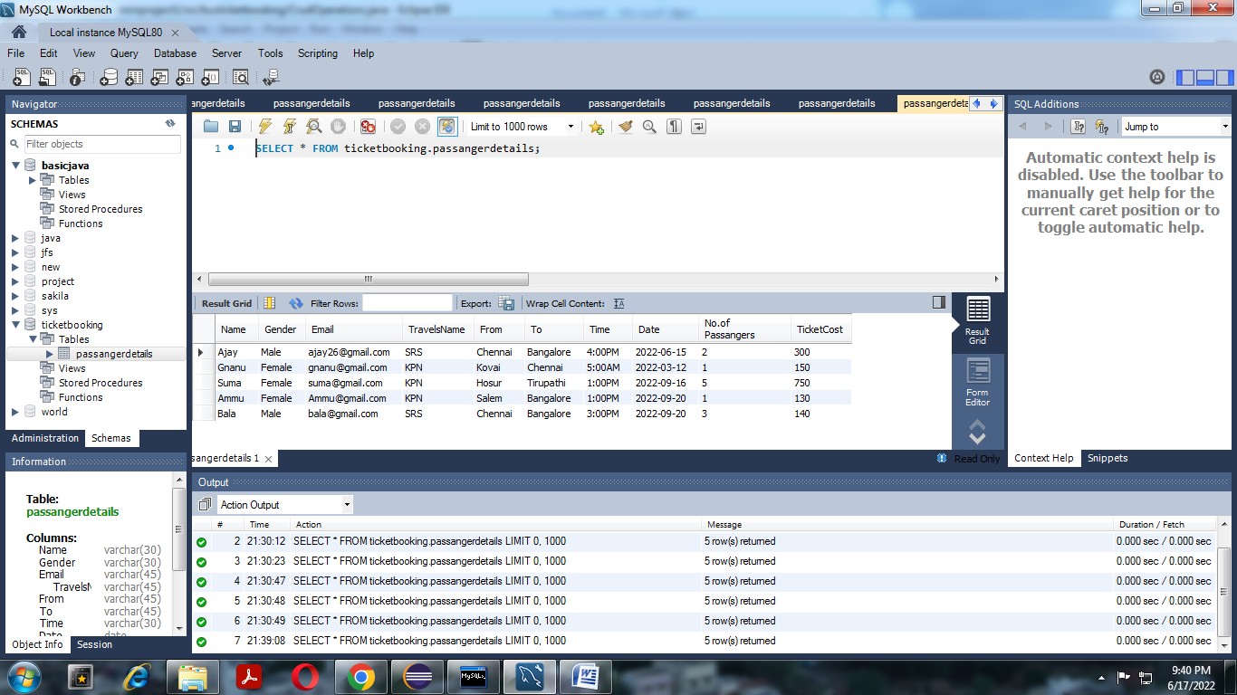
(UPDATE)

Slide 12

(DELETE)

Slide 13
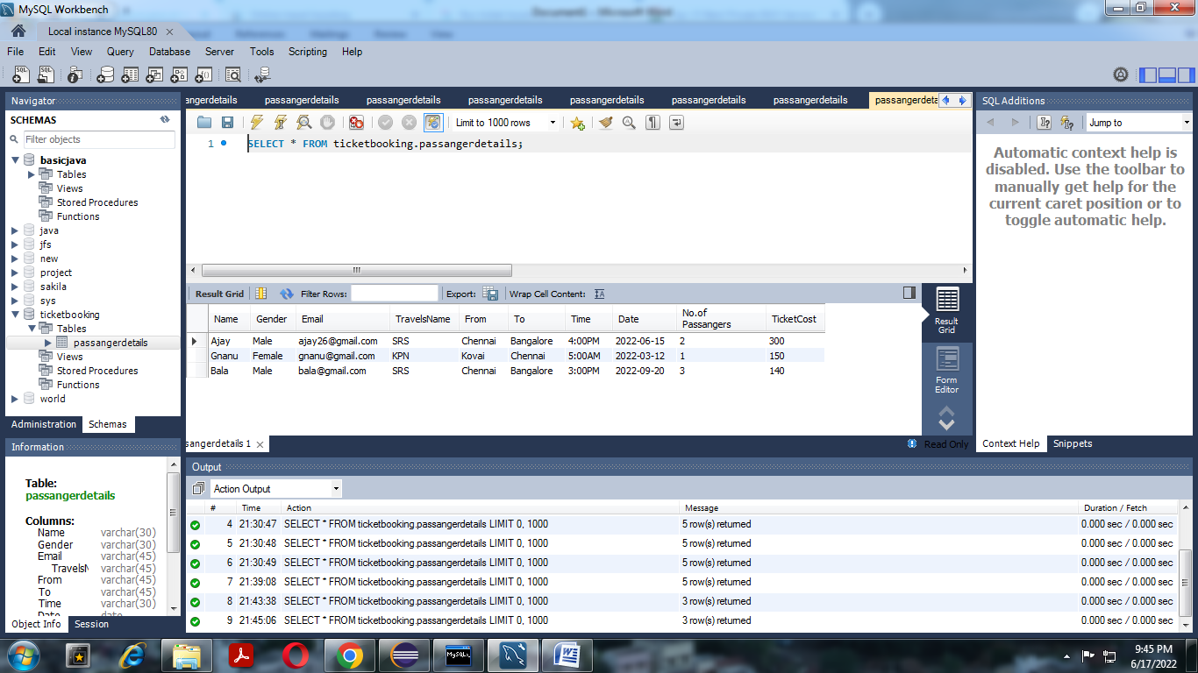
(READ)

Slide 14
CONCLUSION
Online ticket booking system is an application where the customer can book a ticket online and 24*7 hours a day from anyplace in the world. Customers can also interact with the ticket booking website to know any other details they want. Online ticket booking system has been developed successfully. System performance is also found to be satisfactory. This is a user- friendly application. Through this application, the cost can be reduced and efficiency is increased. There are several procedures that can be selected by customers. With the help of this application customers can book tickets, can know the status of a bus a Source station and destination can be chosen according to their choice.

Slide 15
THANK YOU

